Slide 1

FULL STACK WEB DEVELOPMENT USING MERN
Unit I
Dr. Roshan d suvaris

Slide 2
Introduction
The MERN stack is a solution composed of four main components:
MongoDB: A database that uses a document-oriented data model.
ExpressJS: A web application framework for building web applications and APIs.
ReactJS: A declarative, component-based, and isomorphic JavaScript library for building user interfaces.
Node.js: A cross-platform JavaScript runtime environment built on Chrome's V8 JavaScript engine allows developers to build diverse tools, servers, and applications
These fundamental components that comprise the MERN stack are open source, and are thus maintained and developed by a great community of developers. What ties these components together is a common language, JavaScript.

Slide 3
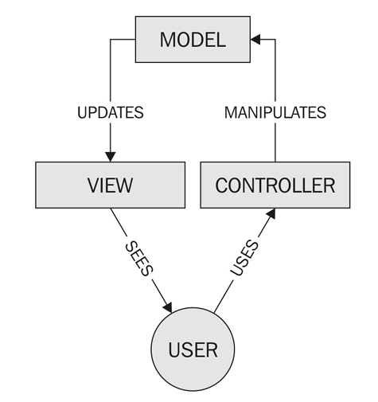
The MVC architectural pattern
Most modern web applications implement the MVC architectural pattern. It consists of three interconnected parts that separate the internal representation of information in a web application:
Model: Manages the business logic of an application that determines how data should be stored, created, and modified
View: Any visual representation of the data or information
Controller: Interprets user-generated events and transforms them into commands for the model and view to update accordingly
The Separation of Concern (SoC) design pattern separates frontend from backend code. Following the MVC architectural pattern, developers are able to adhere to the SoC design pattern, resulting in a consistent and manageable application structure.

Slide 4
MERN Components
React
React is an open-source JavaScript library maintained by Facebook that can be used for creating views rendered in HTML.
Unlike AngularJS, React is not a framework. It is a library. Thus, it does not, by itself, dictate a framework pattern such as the MVC pattern. You use React to render a view (the V in MVC).

Slide 5
Things about React that make it stand out.
Why Facebook Invented React
The Facebook folks built React for their own use, and later they made it open-source.
React was developed by Facebook's Ads team because their traditional MVC-based application became difficult to manage as it grew larger.
In the MVC approach, a single change in data could trigger multiple updates, making the code complex and hard to maintain.
To solve this problem, React introduced a declarative programming model, where developers describe how the user interface should look, and React automatically updates the UI whenever the data (state) changes.
This approach makes applications easier to build, maintain, and debug.

Slide 6
Declarative
React follows a declarative programming approach, which means developers only need to describe what the user interface (UI) should look like based on the current data or state. React automatically updates the UI whenever the data changes, so developers do not have to manually modify the HTML elements (DOM).
In traditional JavaScript libraries like jQuery, developers manually update the DOM whenever the data changes. For example, if a new row is added to a table, the programmer must write code to create and insert that row into the DOM. In React, the developer simply updates the application state, and React automatically determines what changes are needed and updates only the affected parts of the webpage.
React achieves this efficiency by using the Virtual DOM, which is a lightweight, in-memory copy of the real DOM. Whenever the state changes, React creates a new Virtual DOM, compares it with the previous version (a process called diffing), identifies the differences, and updates only those parts of the actual DOM that have changed. This minimizes unnecessary DOM operations, making React applications faster and more efficient.

Slide 7
Component-Based
The fundamental building block of React is a component that maintains its own state and renders itself.
In React, all you do is build components.
Then, you put components together to make another component that depicts a complete view or page.
A component encapsulates the state of data and the view, or how it is rendered.
This makes writing and reasoning about the entire application easier, by splitting it into components and focusing on one thing at a time.
Components talk to each other by sharing state information in the form of read-only properties to their child components and by callbacks to their parent components.

Slide 8
No Templates
Many web application frameworks rely on templates to automate the task of creating repetitive HTML or DOM elements. The templating language in these frameworks is something that the developer will have to learn and practice. Not in React.
React uses a full-featured programming language to construct repetitive or conditional DOM elements. That language is none other than JavaScript. For example, when you want to construct a table, you’d write a for(...) loop in JavaScript or use the map() function of Array.
There is an intermediate language to represent a Virtual DOM, and that is JSX (short for JavaScript XML), which is very much like HTML. This lets you create nested DOM elements in a familiar language rather than hand-construct them using JavaScript functions. Note that JSX is not a programming language; it is a representational markup like HTML.
Isomorphic
React can be run on the server too. That’s what isomorphic means: the same code can run on the server and the browser.

Slide 9
Node.js
Node.js is JavaScript outside of a browser.
The creators of Node.js just took Chrome’s V8 JavaScript engine and made it run independently as a JavaScript runtime.
If you are familiar with the Java runtime that runs Java programs, you can easily relate to the JavaScript runtime: the Node.js runtime runs JavaScript programs.
It is a robust and scalable environment to run the back-end of any application
Node.js Modules
In a browser, you can load multiple JavaScript files, but you need an HTML page to do all that. You cannot refer another JavaScript file from one JavaScript file.
But for Node.js, there is no HTML page that starts it all. In the absence of the enclosing HTML page, Node.js uses its own module system based on CommonJS to put together multiple JavaScript files.
Modules are like libraries. You can include the functionality of another JavaScript file (provided it’s written to follow a module’s specifications) by using the require keyword (which you won’t find in a browser’s JavaScript).
You can therefore split your code into files or modules for the sake of better organisation and load them using require.
Node.js ships with a bunch of core modules compiled into the binary. These modules provide access to the operating system elements such as the file system, networking, input/output, etc.

Slide 10
Node.js and npm
npm is the default package manager for Node.js. You can use npm to install third-party libraries (packages) and manage dependencies between them.
The npm registry (www.npmjs.com) is a public repository of all modules published by people for the purpose of sharing.
Although npm started off as a repository for Node.js modules, it quickly transformed into a package manager for delivering other JavaScript based modules, notably, those that can be used in the browser.
Many popular JavaScript libraries such as React, jQuery, Angular, and Vue.js are available as npm packages. Although React can be included directly in an HTML file using a CDN link, it is recommended to install React using npm because it simplifies dependency management, version control, and project maintenance.
Once React and other libraries are installed using npm, they cannot be used directly in the browser. Therefore, build tools such as Webpack, Browserify, or Vite are used to combine (bundle) all the project files and third-party libraries into optimized JavaScript files that can be loaded by the browser.

Slide 11
Node.js is event-driven
Node.js is an event-driven, asynchronous, and non-blocking JavaScript runtime environment.
Unlike many traditional programming languages that use multiple threads to perform several tasks simultaneously, Node.js uses a single-threaded event loop to handle multiple requests efficiently.
This architecture makes Node.js highly suitable for building fast and scalable web applications.
In an event-driven programming model, the execution of a program is controlled by events such as user actions, file operations, database queries, or network requests.
Instead of waiting for an operation to finish, Node.js registers a callback function that is automatically executed when the event is completed.
For example, when a file is opened, Node.js continues executing other code instead of waiting. Once the file is ready, an event is generated, and the associated callback function is invoked.

Slide 12
Express
Node.js is just a runtime environment that can run JavaScript. To write a full-fledged web server by hand on Node.js directly is not easy, neither is it necessary. Express is a framework that simplifies the task of writing the server code.
The Express framework lets you define routes, specifications of what to do when an HTTP request matching a certain pattern arrives.
The matching specification is regular expression (regex) based and is very flexible, like most other web application frameworks.
The what-to-do part is just a function that is given the parsed HTTP request.
Express parses the request URL, headers, and parameters for you.
On the response side, it has, as expected, all functionality required by web applications.
This includes determining response codes, setting cookies, sending custom headers, etc.
Further, you can write Express middleware, custom pieces of code that can be inserted in any request/response processing path to achieve common functionality such as logging, authentication, etc.
Express does not have a template engine built in, but it supports any template engine of your choice such as pug, mustache, etc.
But, for an SPA, you will not need to use a server-side template engine. This is because all dynamic content generation is done on the client, and the web server only serves static files and data via API calls.

Slide 13
MongoDB
MongoDB is the database used in the MERN stack. It is a NoSQL document-oriented database, with a flexible schema and a JSON-based query language.
1. NoSQL
NoSQL (Not Only SQL) is a non-relational database that stores data in flexible document formats instead of traditional tables with rows and columns.
It supports horizontal scaling by distributing data across multiple servers, making it suitable for large-scale applications.
MongoDB, a popular NoSQL database, stores data as JSON-like documents, which closely match JavaScript objects used in applications.
This eliminates the need for an Object Relational Mapping (ORM) layer and simplifies application development.
Due to its flexibility, scalability, and seamless integration with JavaScript technologies, MongoDB is widely used in the MERN Stack for developing modern web applications.

Slide 14
2. Document-Oriented
Compared to relational databases where data is stored in the form of relations, or tables, MongoDB is a document-oriented database.
The unit of storage (comparable to a row) is a document, or an object, and multiple documents are stored in collections (comparable to a table).
Every document in a collection has a unique identifier, using which it can be accessed. The identifier is indexed automatically.
Modern relational databases have started supporting one level of nesting by allowing array fields and JSON fields, but it is not the same as a true document database.
MongoDB has the ability to index on deeply nested fields, which relational databases cannot do.
The downside is that the data is stored de-normalized. This means that data is sometimes duplicated, requiring more storage space.

Slide 15
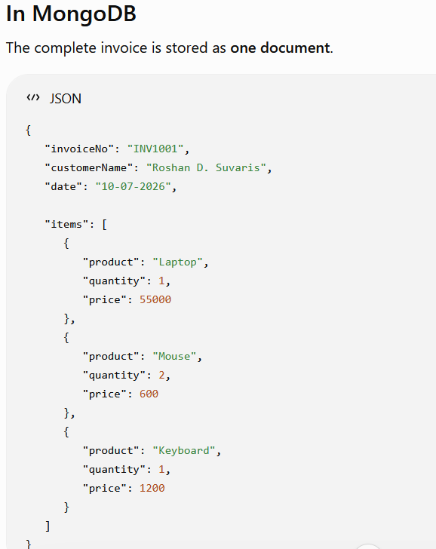
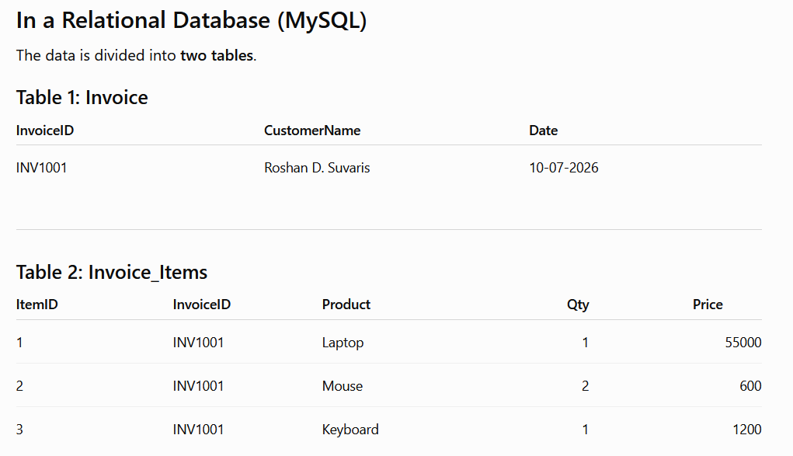
Continued…

Slide 16
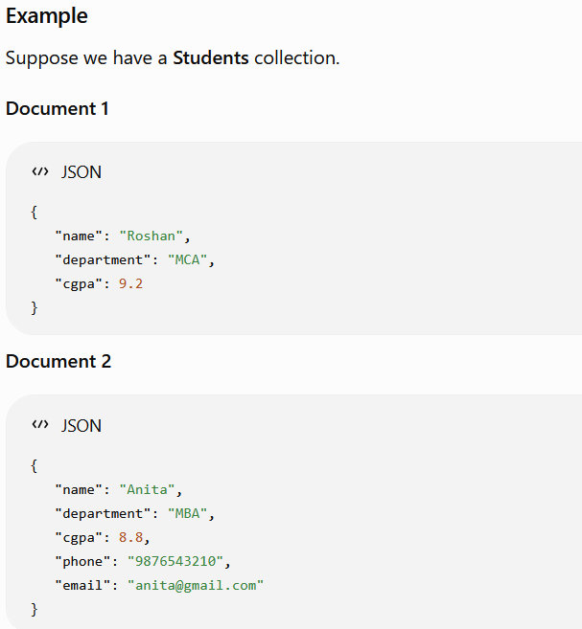
3. Schema-Less
MongoDB is a schema-less database, which means documents in the same collection do not need to have the same structure or fields.
Developers can easily add, remove, or modify fields without changing the database schema, making application development faster and more flexible.
However, since the database does not enforce a fixed structure, the responsibility for maintaining data consistency lies with the application.
For larger applications, tools like Mongoose can be used to define and enforce schemas.

Slide 17
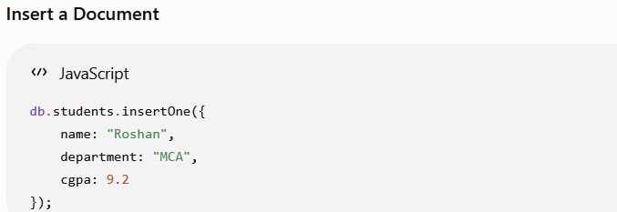
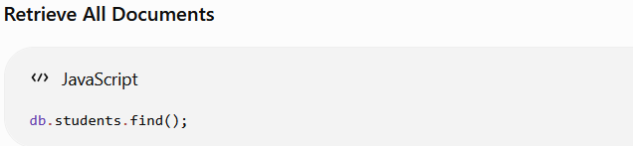
4. JavaScript-Based MongoDB
MongoDB is a JavaScript-based NoSQL database, where queries and data are represented using JSON-like documents.
Instead of using SQL commands such as SELECT, INSERT, or WHERE, MongoDB performs operations using JavaScript objects, making it easy for JavaScript developers to work with the database.
Internally, MongoDB stores data in BSON (Binary JSON), which is an efficient binary representation of JSON.
MongoDB also provides a JavaScript shell (MongoDB Shell) that allows developers to interact with the database using JavaScript commands.
Example

Slide 18
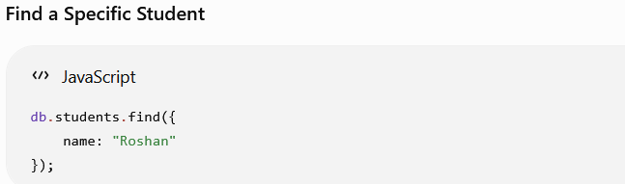
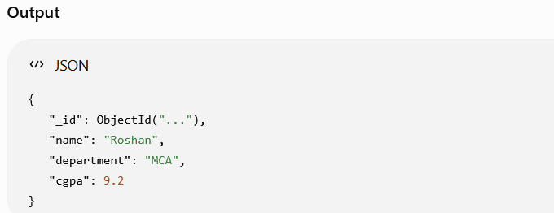

Slide 19
Tools and Libraries
It’s hard to build any web application without using tools to help you on your way. Here’s a brief introduction to the other tools apart from the MERN stack components that we will be using to develop the sample application.
React Router – Summary
React Router is a library used in React applications to enable navigation between different pages or components without reloading the entire web page.
It keeps the browser URL synchronized with the displayed component and manages browser history, including the Back and Forward buttons.
This allows React applications to behave like Single Page Applications (SPAs), providing faster navigation and a better user experience.
React-Bootstrap
Bootstrap, the most popular CSS framework, has been adapted to React and the project is called React Bootstrap.
This library not only gives us most of the Bootstrap functionality, but the components and widgets provided by this library also give us a wealth of information on how to design our own widgets and components.
There are other component/CSS libraries built for React (such as Material-UI, MUI, Elemental UI, etc.) and also individual components (such as react-select, react-treeview, and react-date-picker).

Slide 20
Webpack
Webpack is a powerful module bundler used in modern JavaScript and React applications.
It combines multiple JavaScript files, CSS files, images, and other resources into one or more optimized bundle files that can be efficiently loaded by the browser.
Webpack also works with Babel to compile JSX code into standard JavaScript that browsers can understand.
This simplifies project management, improves performance, and makes application development more organized.

Slide 21
Other Popular Libraries
Although we will not be using these libraries as part of this book, some that are very popular additions to the MERN stack and are used together are:
• Redux: This is a state management library that also combines the Flux programming pattern. It’s typically used in larger projects where even for a single screen, managing the state becomes complex.
• Mongoose: If you are familiar with Object Relational Mapping layers, you may find Mongoose somewhat similar. This library adds a level of abstraction over the MongoDB database layer and lets the developer see objects as such. The library also provides other useful conveniences when dealing with the MongoDB database.
• Jest: This is a testing library that can be used to test React applications easily.

Slide 22
Why MERN?
The MERN Stack (MongoDB, Express.js, React, and Node.js) is one of several popular technologies used for web development. It is not necessarily better than other stacks such as LAMP or MEAN; the best choice depends on the developer's experience, project requirements, and timeline.
It is ideally suited for web applications that have a large amount of interactivity built into the front-end.
MERN is an excellent choice for building interactive, dynamic, and Single Page Applications (SPAs) because React provides efficient user interface rendering.
Key Advantages of MERN
Uses JavaScript for both frontend and backend development.
Ideal for highly interactive web applications.
React provides fast UI updates using the Virtual DOM.
MongoDB stores data in flexible JSON-like documents.
Easy integration between all four technologies.

Slide 23
Example Applications Built Using MERN
Facebook-like social networking sites
E-commerce websites
Online Learning Management Systems (LMS)
Hospital Management Systems
Banking and Finance Applications
Real-time Chat Applications
Online Food Ordering Systems

Slide 24
1. JavaScript Everywhere
One of the biggest advantages of the MERN Stack is that it uses JavaScript throughout the entire application, including the frontend (React), backend (Node.js and Express), and database operations (MongoDB).
Developers only need to learn one programming language, making development easier and more efficient.
Unlike other web technologies, React generates user interfaces using JavaScript instead of a separate template language, allowing developers to use the full capabilities of JavaScript.
Using a single language across all layers also enables code sharing, such as validation and business logic, between the client and the server, reducing code duplication and improving application consistency.

Slide 25
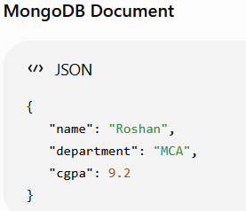
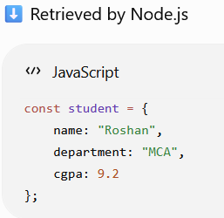
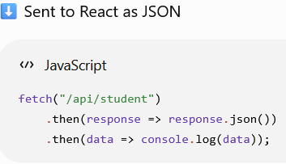
2. JSON Everywhere
One of the major advantages of the MERN Stack is that JSON (JavaScript Object Notation) is used throughout the application.
Data is stored in MongoDB as BSON (Binary JSON), processed in Node.js/Express as JavaScript objects, transferred between the server and client in JSON format, and used directly in React.
This eliminates the need for complex data transformations, Object Relational Mapping (ORM), and serialization/deserialization code.
As a result, developers can work with the same data format across all layers of the application, making development simpler, faster, and more efficient.
Example :

Slide 26
3. Node.js Performance
Due to its event-driven architecture and non-blocking I/O, the claim is that Node.js is very fast and a resilient web server.
when your application starts scaling and receiving a lot of traffic, this will play an important role in cutting costs and savings in terms of time spent in trouble-shooting server CPU and I/O problems.
4. The npm ecosystem
The npm (Node Package Manager) ecosystem is one of the largest collections of open-source JavaScript packages available for developers.
It provides thousands of reusable libraries and tools that simplify application development and reduce the need to write code from scratch.
If a required package does not exactly meet the developer's needs, it can be modified (forked) and customized.
Because JavaScript packages are generally small and lightweight, npm offers fast installation, easy dependency management, and efficient project development.

Slide 27
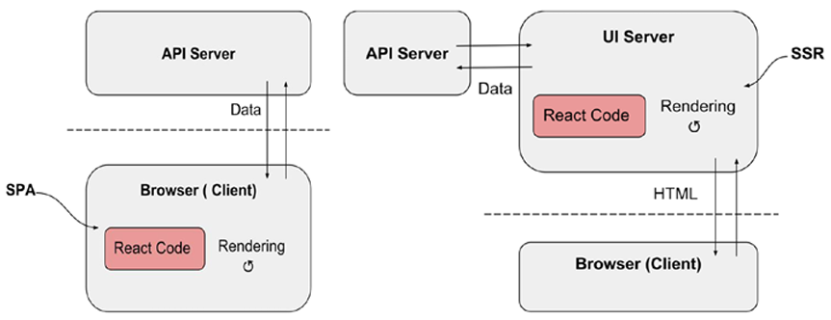
5. Isomorphic
With the MERN stack, serving complete pages out of the server is natural and doesn’t require tools that are after-thoughts.
This is possible because React runs on JavaScript, which is the same on the client or the server.
When React-based code runs on the browser, it gets data from the server and constructs the page (DOM) in the browser. This is the SPA way of rendering the UI.
If we wanted to generate the same page in the server for search engine bots, the same React-based code can be used to get the data from an API server and construct the page (this time, as an HTML) and stream that back to the client. This is called server-side rendering (SSR).
What makes this possible is the fact that the same language is used to run the UI construction code in the server and the browser: JavaScript. This is what is meant by the term isomorphic.

Slide 28
It’s Not a Framework!
React is a JavaScript library for building user interfaces rather than a complete framework.
Unlike frameworks, which enforce a fixed structure and way of developing applications, React gives developers the flexibility to choose the tools and architecture that best suit their project.
This makes React easier to customize and integrate with other libraries as application requirements evolve.
Although frameworks can speed up initial development, React's library-based approach offers greater control, flexibility, and scalability, making it ideal for building modern and complex web applications.

Slide 29
Simple program

Slide 30
Serverless Hello World
A simple piece of code in a single HTML file that uses React to display a simple page in the browser.
No installations, downloads, or server!
Include HTML tags such as <html>, <head>, and <body>. Then, include the React library.
The React library is available as a JavaScript file that we can include in the HTML file using the <script> tag.
It comes in two parts:
The first is the React core module, the one that is responsible for dealing with React components, their state manipulation, etc.
The second is the ReactDOM module, which deals with converting React components to a DOM that a browser can understand.
These two libraries can be found in unpkg, a Content Delivery Network (CDN) that makes all open-source JavaScript libraries available online.
• React: https://unpkg.com/react@16/umd/react.development.js
• ReactDOM: https://unpkg.com/react-dom@16/umd/react-dom.development.js

Slide 31
Next, within the body, let’s create a that will eventually hold any React elements that we will create. This can be an empty, but it needs an ID, say, content, to identify and get a handle in the JavaScript code.
<div id="content"></div>
To create the React element, the createElement() function of the React module needs to be called. The function takes up to three arguments and its prototype is as follows:
React.createElement(type, [props], [...children])
The type can be any HTML tag such as the string 'div', or a React component
props is an object containing HTML attributes or custom component properties.
The last parameter(s) is zero or more children elements, which again are created using the createElement() function itself.
A <div> with a title attribute (just to show how attributes work) that contains a heading with the words “Hello World!” Here is the JavaScript code snippet for creating our first React element, which will go inside a <script> tag within the body.

Slide 32
...
const element = React.createElement('div', {title: 'Outer div'},
React.createElement('h1', null, 'Hello World!’)
);
...
A React element (the result of a React.createElement() call) is a JavaScript object that represents what is shown on screen.
Since it can be a nested collection of other elements and can depict everything on the entire screen, it is also called the virtual DOM and it is there in the browser’s memory.
It resides in the JavaScript engine’s memory as a deeply nested set of React elements, which are also JavaScript objects.
Each of these React elements needs to be transferred to the real DOM for the user interface to be constructed on screen.
To do this, a series of document.createElement() calls needs to be made corresponding to each of the React elements.
The ReactDOM does this when the ReactDOM.render() function is called. This function takes in as arguments the element that needs to be rendered and the DOM element that it needs to be placed under.

Slide 33
We already constructed the element that needs to be rendered using React.createElement(). As for the containing element, we have a that we created in the body, which is the target where the new element needs to be placed.
We can get the parent's handle by calling document.getElementByID(), as we would have done using regular JavaScript.
...
ReactDOM.render(element, document.getElementById('content’));
...

Slide 34
Example to display hello world – index.html
<!DOCTYPE HTML>
<html>
<head>
<meta charset="utf-8">
<title>Pro MERN Stack</title>
<script src="https://unpkg.com/react@16/umd/react.development.js"></script>
<script src="https://unpkg.com/react-dom@16/umd/react-dom.development.js"></script>
</head>
<body>
<div id="content"></div>
<script>
const element = React.createElement('div', {title: 'Outer div’},
React.createElement('h1', null, 'Hello World!’)
);
ReactDOM.render(element, document.getElementById('content'));
</script>
</body>
</html>
Executing the program
Open VS Code
Create a folder
Create a program called index.html in the folder
Write the code in index.html
Open the terminal and go to the folder
Run npx http-server
Copy the link and paste it in browser for example http://192.168.1.33:8081

Slide 35
JSX
React.createElement() - imagine writing a deeply nested hierarchy of elements and components: it can get pretty complex if we use React.createElement().
To address this, React has a markup language called JSX, which stands for JavaScript XML.
JSX looks very much like HTML, but there are some differences.
So, instead of the React.createElement() calls, JSX can be used to construct an element or an element hierarchy and make it look very much like HTML.
...
const element = (
<div title="Outer div">
<h1>Hello World!</h1>
</div>
);
...
Note that although it is strikingly close to HTML syntax, it is not HTML.
Note also that the markup is not enclosed within quotes, so it is not a string that can be used as an innerHTML either.
It is JSX, and it can be freely mixed with JavaScript.

Slide 36
the differences between HTML and JSX are not earth-shaking and they are very logical.
It is easy to understand how the screen will look when you read JSX, because it is very similar to HTML. So, for the rest of the book, we use JSX.
But browsers’ JavaScript engines don’t understand JSX. It has to be transformed into regular JavaScript based React.createElement() calls.
To do this, a compiler is needed. The compiler that does this is Babel.
We should ideally pre-compile the code and inject it into the browser, but for prototyping purposes, Babel provides a standalone compiler that can be used in the browser.
This is available as a JavaScript file, as usual, at unpkg.
...
<script src="https://unpkg.com/@babel/standalone@7/babel.min.js"></script>
...
But the compiler also needs to be told which scripts have to be transformed. It looks for the attribute type="text/babel" in all scripts and transforms and runs any script with this attribute.

Slide 37
Example - index.html
<!DOCTYPE HTML>
<html>
<head>
<meta charset="utf-8">
<title>Pro MERN Stack</title>
<script src="https://unpkg.com/react@16/umd/react.development.js"></script>
<script src="https://unpkg.com/react-dom@16/umd/react-dom.development.js"></script>
<script src="https://unpkg.com/@babel/standalone@7/babel.min.js"></script>
</head>
<body>
<div id="contents"></div>
<script type="text/babel">
//const element = React.createElement('div', {title: 'Outer div’},
//React.createElement('h1', null, 'Hello World!’));
const element = (<div title="Outer div">
<h1>Hello World!</h1>
</div>);
ReactDOM.render(element, document.getElementById('contents'));
</script>
</body></html>

Slide 38
When you test this set of changes, you will find no difference in the appearance of the page, but it could be a wee bit slower due to the compilation done by Babel.
Switch to compiling JSX at build time rather than at runtime to get rid of the performance impact.

Slide 39
Project Setup
The server-less setup is useful for learning React because it does not require any installation or server configuration.
However, it is not suitable for development or production, as loading React and Babel from a CDN increases page loading time, and compiling JSX in the browser reduces performance.
For real-world applications, it is better to use an HTTP server and organize the project into proper folders while installing the required libraries locally.
This provides faster execution, easier development, and better application performance.
We will discuss the following concepts to create a folder and store the libraries in it.
nvm
Node.js
Project
npm

Slide 40
1. nvm
This stands for Node Version Manager; that tool makes installation and switching between multiple versions of Node.js easy.
Note - Node.js can be installed directly without nvm which can be used to develop the MERN projects. So nvm is optional.
To install nvm, if you are using Mac OS or any Linux-based distribution - This can be found at https://github.com/creationix/nvm.
Windows users to install a Linux virtual machine (VM), preferably using Vagrant, and do all the server-side coding within the VM. This usually works best, especially because the code is finally deployed almost always on a Linux server, and having the same environment for development works best.
One tricky thing about nvm is knowing how it initialises your PATH. This works differently on different operating systems, so make sure you read up on the nuances.
Essentially, it adds a few lines to your shell's initialization scripts so that the next time you open a shell, your PATH is initialized and executes nvm's initialization scripts.
This lets nvm know about the different versions of Node.js that are installed, and the path to the default executable.

Slide 41
2. Node.js
After installing NVM (Node Version Manager), install the Long Term Support (LTS) version of Node.js, as it provides better stability, security updates, and long-term support for MERN development.
nvm install lts
or install a specific version:
nvm install 22.17.0
Activate the installed version (Windows):
nvm use 22.17.0
Verify the installation:
node --version npm --version
Using the LTS version ensures that your MERN applications run on a stable and well-supported Node.js environment.
After installing Node.js through NVM, verify that the correct version is active by using the node --version command.
On Windows, NVM does not support the nvm alias command, so you need to run nvm use <version> whenever you open a new terminal.
Installing Node.js automatically installs npm, which can be verified using npm --version.
If required, you can update npm globally using the npm install -g npm@<version> command.
# Update npm globally (example) npm install -g npm@11

Slide 42
3. Project
Before we install any third-party packages with npm, it's a good idea to initialize the project.
With npm, even an application is considered a package. A package defines various attributes of the application.
One such important attribute is a list of other packages that the application depends upon.
This will change over time, as we find a need to use libraries as we make progress with the application.
To start with, we need at least a placeholder where these things will be saved and initialized.
Let’s create a directory called pro-mern-stack to host the application.
Let’s initialize the project from within this directory like this:
$ npm init
you should be in the project directory for all shell commands, especially npm commands
This will ensure that all changes and installations are localized to the project directory.

Slide 43
4. npm
To install anything using npm, the command to be used is npm install <package>.
To start off, and because we need an HTTP server, let's install Express using npm.
$ npm install express
it installs all other packages that Express depends upon as well.
To install specific version use:
$ npm install express@4

Slide 44
The location of the installed files under the project directory is a conscious choice that the makers of npm made. This has the following effect:
In npm, all packages are installed locally within the project directory, allowing each project to use its own package versions independently. This avoids compatibility issues when working on multiple Node.js projects with different requirements. Since npm packages are generally small in size, installing separate copies for different projects does not significantly increase disk usage. This approach makes project management easier and more reliable.
A package's dependencies are also isolated within the package. Thus, two packages depending on different versions of a common package could be installed, and they would each have their own copy and therefore work flawlessly.
Administrator (superuser) rights are not needed to install a package
There is, of course, an option to install packages globally, and sometimes it is useful to do this.
In such cases, the –g option of npm install can be used to install a package globally and made available everywhere.

Slide 45
Express
Express is the best way to run an HTTP server in the Node.js environment.
(We’ll use Express to serve only static files. This is so that we get used to what Express does, without getting into a lot of server-side coding. We’ll serve the index.html file that we created previously via Express.)
Install express/ when in doubt we can run the following command (latest stable version of Express.js is 5.2.1)
$ npm install express@5.2.1
To start using Express, let’s import the module and use the top-level function that the module exports, in order to instantiate an application. This can be done using the following code:
...
const express = require('express');
...
require is a JavaScript keyword specific to Node.js, and this is used to import other modules.
All needed scripts were included directly in HTML files only.

Slide 46
An Express application is web server that listens on a specific IP address and port. Multiple applications can be created, which listen on different ports.
instantiate the one and only application by calling the express() function:
...
const app = express();
...
Express is a framework that does minimal work by itself; instead, it gets most of the job done by functions called middleware.
A middleware is a function that takes in an HTTP request and response object, plus the next middleware function in the chain.
The function can look at and modify the request and response objects, respond to requests, or decide to continue with middleware chain by calling the next middleware function.
We need something that looks at a request and returns the contents of a file based on the request URL’s path.
The built-in express.static function generates a middleware function

Slide 47
It responds to a request by trying to match the request URL with a file under a directory specified by the parameter to the generator function.
If a file exists, it returns the contents of the file as the response, if not, it chains to the next middleware function.
This is how we can create the middleware:
...
const fileServerMiddleware = express.static('public’);
...
The argument to the static() function is the directory where the middleware should look for the files, relative to where the app is being run.
(Let’s create this new directory, public, under the project root and move index.html)
Middleware in an Express application can be mounted using the use() method of the application.
The first argument to this method is the base URL of any HTTP request to match. The second argument is the middleware function itself.
...
app.use('/', fileServerMiddleware);
...

Slide 48
Now that the application is set up, we’ll need to start the server and let it serve HTTP requests.
The listen() method of the application starts the server and waits eternally for requests.
...
app.listen(3000, function () {
console.log('App started on port 3000');
});
...
It takes in a port number as the first argument.
The listen() method also takes another argument, an optional callback that can be called when the server has been successfully started.

Slide 49
Let’s put all this together in a file called server.js in the root directory of the project.
server.js: Express Server
const express = require('express');
const app = express();
app.use(express.static('public'));
app.listen(3000, function () {
console.log('App started on port 3000');
});
//index.html
<!DOCTYPE html>
<html>
<head>
<title>Express Example</title>
</head>
<body>
<h1>Welcome to Express.js</h1>
<p>This page is served using Express.</p>
</body>
</html>

Slide 50
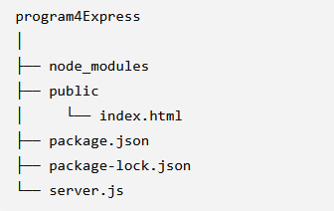
Directory structure ->
Executing the program
PS E:\ReactFolder\program4Express> node --version
v24.18.0
PS E:\ReactFolder\program4Express> npm --version
11.16.0
PS E:\ReactFolder\program4Express> npm init –y
E:\ReactFolder\program4Express> npm install express
dir
dir public
E:\ReactFolder\program4Express> node server.js
Goto browser and type http://localhost:3000/index.html

Slide 51
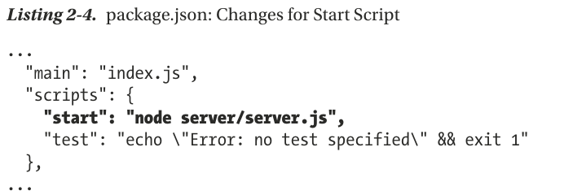
Another way of running the server
npm start
When this is executed, npm looks for the file server.js and runs it using Node.js.
But what if we had a different starting point for the server? In fact, we want all the server-related files to go into a directory called server.
So, let’s create that directory and move server.js into that directory.
Now, if you run npm start, it will fail with an error. That’s because npm looks for server.js in the root (program4Express) directory and doesn’t find it.
In order to let npm know that the entry point for the server is server.js within the sub-directory called server, an entry needs to be added to the scripts section of package.json.
Thus, if the server starting point is anything other than server.js in the root directory, the full command line has to be specified in the scripts section of package.json.

Slide 52
Separate Script File
In the earlier approach, JSX was converted into JavaScript at runtime using Babel in the browser, which slows down application loading and execution.
A better approach is to transform JSX during the build process using tools like Webpack and Babel.
This generates optimised JavaScript files before deployment, resulting in faster performance, improved efficiency, and a production-ready application.
first step, we need to separate out the JSX and JavaScript from the all-in-one index.html and refer to it as an external script.
This way, we can keep the HTML as pure HTML and all the scripts that need compilation in a separate file.
Let’s call this external script App.jsx and place it in the public directory, so that it can be referred to as /App.jsx from the browser.

Slide 53
Example
index.html: Separate HTML and JSX
<!DOCTYPE HTML>
<html>
<head>
<meta charset="utf-8">
<title>Pro MERN Stack</title>
<script src="https://unpkg.com/react@16/umd/react.development.js"></script>
<script src="https://unpkg.com/react-dom@16/umd/react-dom.development.js"></script>
<script src="https://unpkg.com/@babel/standalone@7/babel.min.js"></script>
</head>
<body>
<div id="contents"></div>
<script type="text/babel" src="/App.jsx"></script>
</body>
</html>

Slide 54
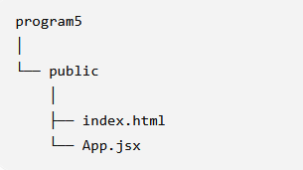
App.jsx: JSX Part Separated Out from the HTML
const element = (
<div title="Outer div">
<h1>Hello World!</h1>
</div>
);
ReactDOM.render(element, document.getElementById('contents'));
If you point your browser to http:// localhost:3000, you should see the same Hello World message
The JSX continues to get transformed by the Babel library script, which was executed in the browser.
Executing the program and folder structure
PS E:\ReactFolder\program5\public> npx http-server
Copy and paste http://10.227.185.215:8080 in browser

Slide 55
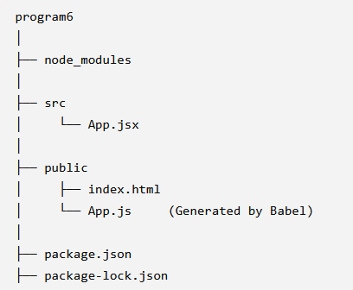
JSX Transform
Initially, JSX code was compiled in the browser at runtime using Babel Standalone, which slows down page loading.
To improve performance, JSX is compiled during development using the Babel command-line tool, producing pure JavaScript files before deployment.
The original JSX files are stored in the src folder, while the compiled JavaScript files are generated in the public folder.
The browser then loads the compiled App.js file directly, eliminating the need for the Babel runtime.
After applying JSX transformation, the project structure becomes:

Slide 56
Example
App.jsx (Stored in src folder)
const element = (
<div title="Outer div">
<h1>Hello World!</h1>
</div>
);
ReactDOM.render(element, document.getElementById('contents'));

Slide 57
index.html (Stored in public folder)
<!DOCTYPE html>
<html>
<head>
<meta charset="utf-8">
<title>React JSX Transform</title>
<script src="https://unpkg.com/react@16/umd/react.development.js"></script>
<script src="https://unpkg.com/react-dom@16/umd/react-dom.development.js"></script>
</head>
<body>
<div id="contents"></div>
<script src="App.js"></script>
</body>
</html>

Slide 58
Execution Sequence
1. Create the project folder
program6
2. Initialize the project
npm init -y
3. Install Babel CLI and Core
npm install --save-dev @babel/core@7 @babel/cli@7
4. Check Babel Version
npx babel --version
5. Install React Preset
npm install --save-dev @babel/preset-react@7
6. Create folders
Create src and public folder
copy App.jsx to src
Index.html to public
7. Compile JSX
npx babel src --presets @babel/preset-react --out-dir public
(It creates App.js in the public folder
8. Move to the public folder
cd public
9. Run HTTP Server
npx http-server
(generates output http://127.0.0.1:8080)
10. Open browser and paste the link

Slide 59
Advantages of JSX Transformation
JSX is compiled before execution, improving performance.
No need to include the Babel Standalone library in the browser.
The browser executes only optimized JavaScript (App.js).
Separating source (src) and compiled (public) files makes the project easier to organize and maintain.
This approach is suitable for both development and production environments.

Slide 60
Automate
Apart from being able to start the project using npm start, npm has the ability to define other custom commands.
This is especially useful when there are many command line parameters for the command and typing them out on the shell becomes tedious.
These custom commands can be specified in the scripts section of package.json. These can then be run using npm run <script> from the console
Let’s add a script called compile whose command line is the Babel command line to do all the transforms.
...
"compile": "babel src --out-dir public",
...
The transform can now be run like this:
$ npm run compile
After this, if you run npm start again to start the server, you can see any changes to App.jsx reflected in the application.

Slide 61
Continued…
When we work on the client-side code and change the source files frequently, we have to manually recompile it for every change.
Babel supports this out of the box via the --watch option.
Add another script called watch with this additional option to the Babel command line:
...
"watch": "babel src --out-dir public --watch --verbose“
...
It is essentially the same command as compile, but with two extra command line options, --watch and –verbose
The first option instructs Babel to watch for changes in source files
second one causes it to print out a line in the console whenever a change causes a recompilation.
A similar restart on changes to the server code can be affected by using a wrapper command called nodemon.
This command restarts Node.js with the command specified whenever there is a change in a set of files.
$ npm install nodemon@1
Now, let’s use nodemon to start the server instead of Node.js in the script specification for start in package.json.

Slide 62
Since all the server files are going to be in the directory called server, we can use -w server to make nodemon restart Node.js when any file in that directory changes.
So, the new command for the start script within package.json will now be:
...
"start": "nodemon -w server server/server.js“
...
The final set of scripts added or changed in package.json is:
...
"scripts": {
"start": "node server/server.js",
"start": "nodemon -w server server/server.js",
"compile": "babel src --out-dir public",
"watch": "babel src --out-dir public --watch --verbose",
"test": "echo \"Error: no test specified\" && exit 1"
},
...

Slide 63
Continued…
If you now run the new command using npm run watch, you will notice that it does one transform, but it doesn’t return to the shell.
It’s actually waiting in a permanent loop, watching for changes to the source files.
So, to run the server, another terminal is needed, where npm start can be executed.
If you make a small change to App.jsx and save the file, you’ll see that App.js in the public directory is regenerated.
And, when you refresh the browser, you can see those changes without having to manually recompile.
You can also make any changes to server.js and see that the server starts, with a message on the console that says the server is being restarted.

Slide 64
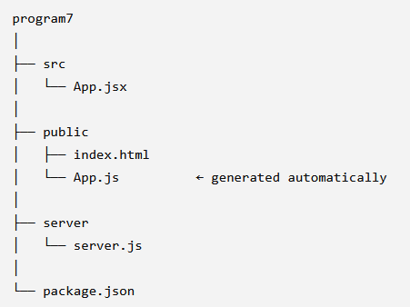
Example:
Let's take a small React + Babel + Express project and automate both JSX compilation and server restarting.
Suppose your project is:

Slide 65
2. Create App.jsx
const element = (
<div>
<h1>Hello World!</h1>
<p>This application uses automatic JSX compilation.</p>
</div>
);
ReactDOM.render(
element,
document.getElementById('contents')
);
3. Create index.html
<!DOCTYPE html>
<html>
<head>
<meta charset="utf-8">
<title>Automated React Example</title>
<script src="https://unpkg.com/react@16/umd/react.development.js"></script>
<script src="https://unpkg.com/react-dom@16/umd/react-dom.development.js"></script>
</head>
<body>
<div id="contents"></div>
<script src="App.js"></script>
</body>
</html>

Slide 66
4. Create Express server
const express = require('express');
const app = express();
app.use(express.static('public'));
app.listen(3000, function () {
console.log('Server started at http://localhost:3000');
});
5. Install the required packages
From the program7 directory:
npm init –y
npm install express //Install Express
npm install --save-dev @babel/core @babel/cli @babel/preset-react //Install Babel
npm install --save-dev nodemon //Install nodemon

Slide 67
6. Configure package.json
Open package.json and change the scripts section to:
{
"name": "program7",
"version": "1.0.0",
"scripts": {
"start": "nodemon -w server server/server.js",
"compile": "babel src --presets @babel/preset-react --out-dir public",
"watch": "babel src --presets @babel/preset-react --out-dir public --watch --verbose"
}
}
7. First compile the JSX
npm run compile
8. Start automatic JSX compilation
npm run watch

Slide 68
Now do the changes in App.jsx and check the output:
<h1>Hello World!</h1> to <h1>Welcome to MERN Development!</h1>
9. Start the server
Open a second terminal.
Make sure you are in the project directory:
cd E:\ReactFolder\program7
npm start
You should get: Server started at http://localhost:3000
Open: http://localhost:3000
10. Test Nodemon
Now open: server/server.js
Change: console.log('Server started at http://localhost:3000’); to console.log('MERN server restarted automatically!’);
Save the file.
Nodemon detects the change and automatically restarts the server.

Slide 69
Node.js and npm

Slide 70
Node.js and npm

Slide 71
Node.js and npm

Slide 72
Node.js and npm

Slide 73
Node.js and npm

Slide 74
Node.js and npm

Slide 75
Node.js and npm

